Slide 1
Geometric Transformations for
Computer Graphics
Shmuel Wimer
Bar Ilan Univ., School of Engineering
April 2010

Slide 2

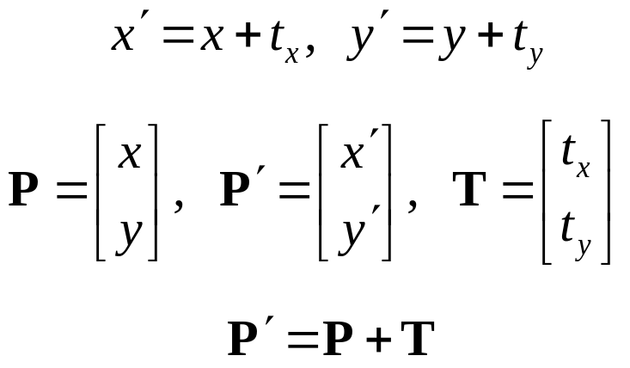




2D Translation
April 2010

Slide 3
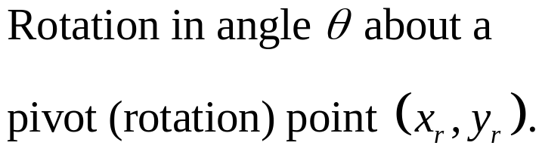



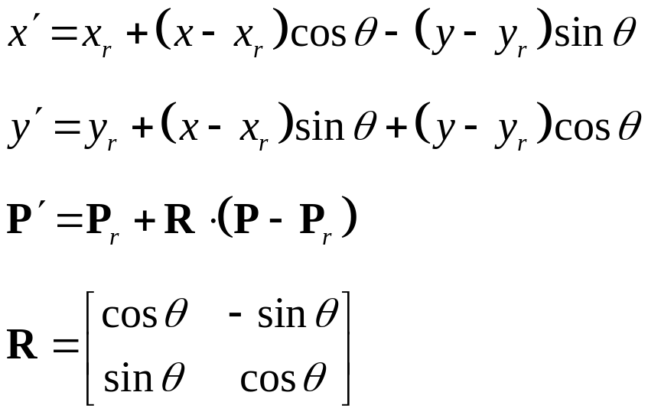
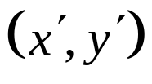
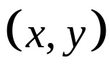
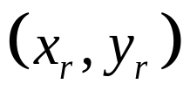
2D Rotation
April 2010

Slide 4
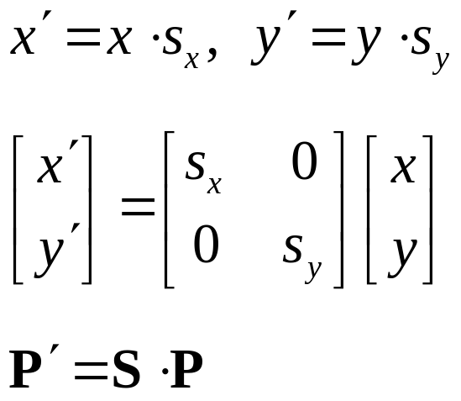


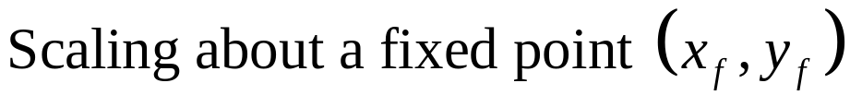
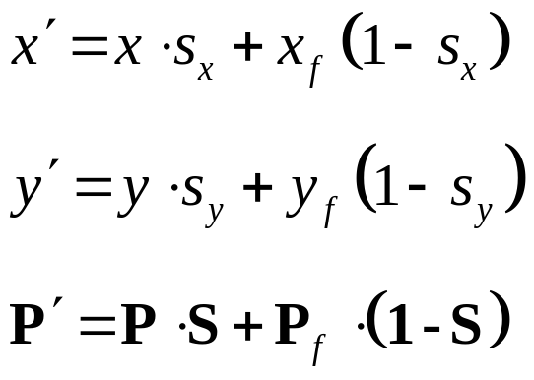
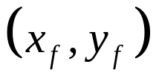
2D Scaling
April 2010

Slide 5
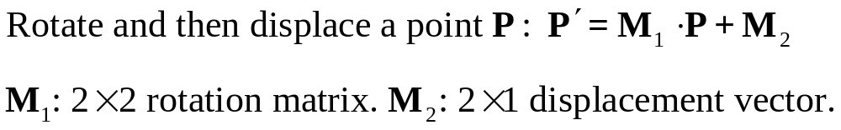
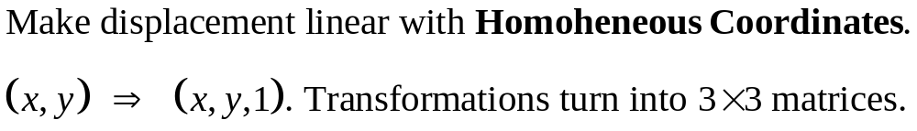

Homogeneous Coordinates
April 2010

Slide 6
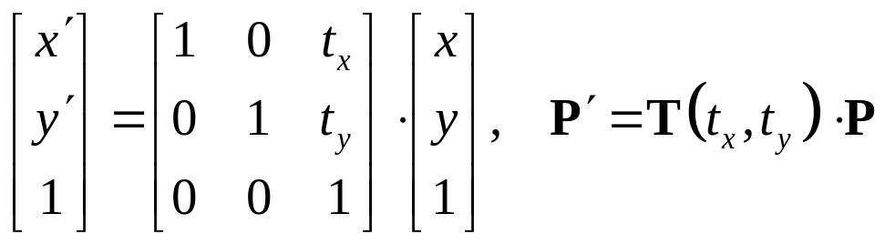
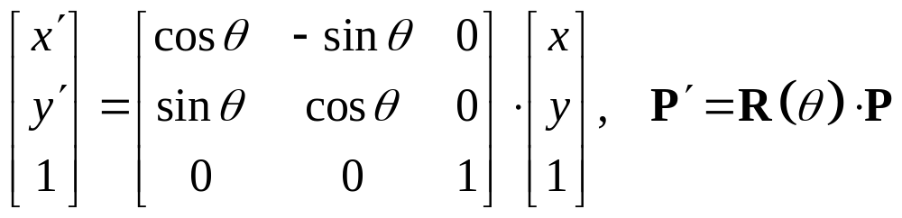
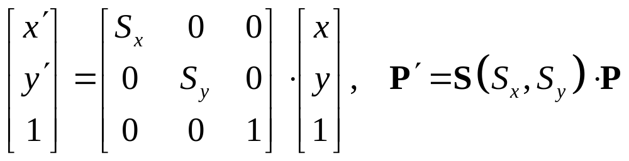
2D Translation
2D Rotation
2D Scaling
April 2010

Slide 7
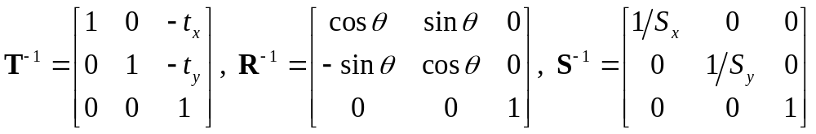

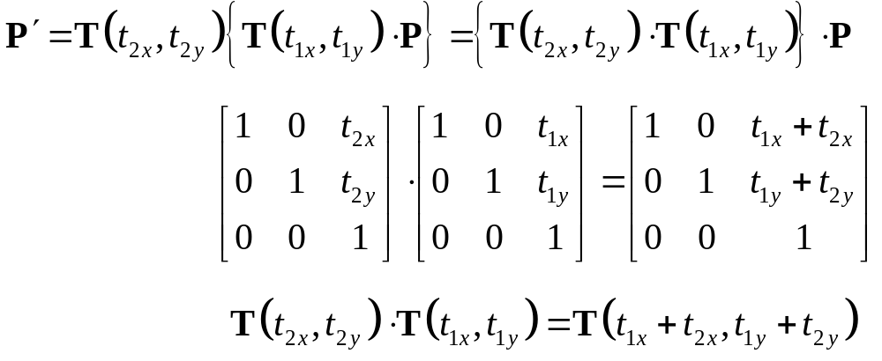
Inverse transformations:
Composite transformations:
Composite translations:
April 2010

Slide 8
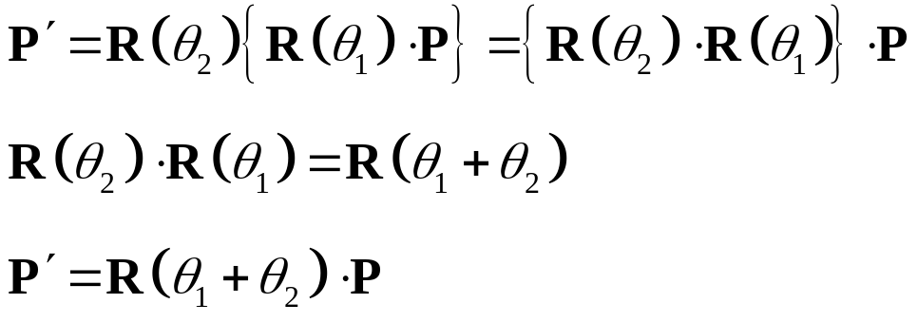
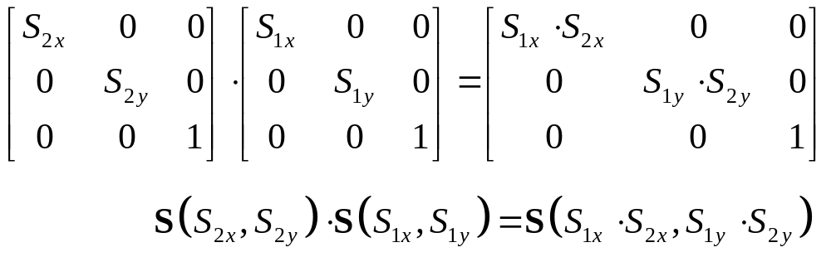
Composite Rotations:
Composite Scaling:
April 2010

Slide 9

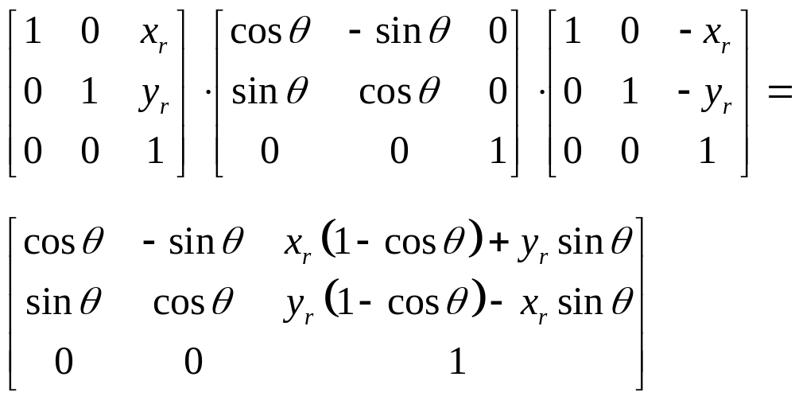
General 2D Rotation
Move to origin
Rotate
Move back
April 2010

Slide 10
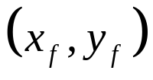
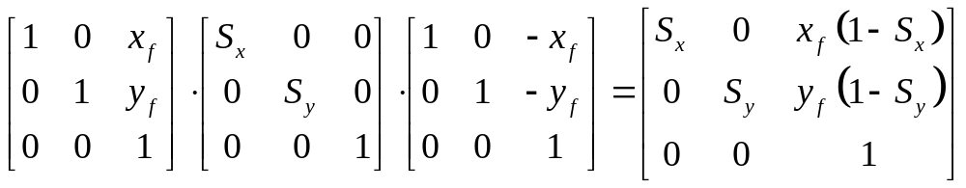
General 2D Scaling
Move to origin
Scale
Move back
April 2010

Slide 11


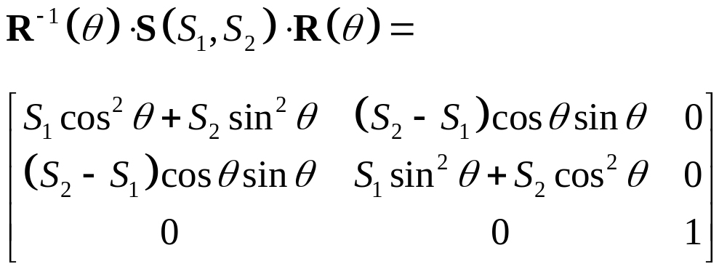


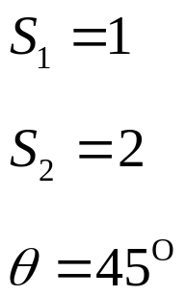
2D Directional Scaling
April 2010

Slide 12



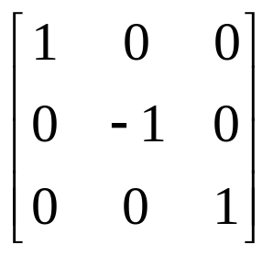
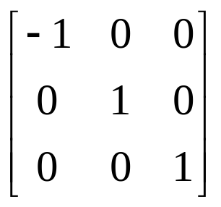
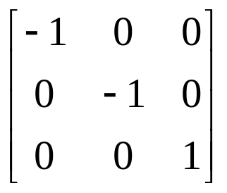
2D Reflections
April 2010

Slide 13


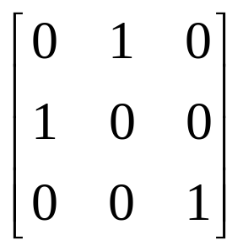
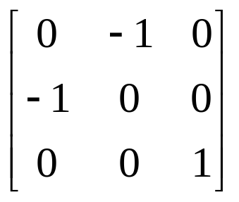
3
2
2
1
1
3
1
3
2
1
2
3
April 2010

Slide 14



Geometric Transformations by Rasterization
The transformed shape needs to be filled.
  A whole scan-line filling is usually in order.
However, simple transformations can save new filling by manipulating blocks in the frame buffer.
Translation:
Move block of pixels of frame buffer into new destination.
April 2010

Slide 15
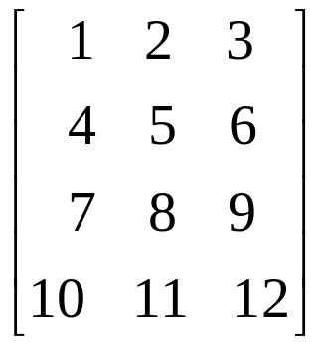
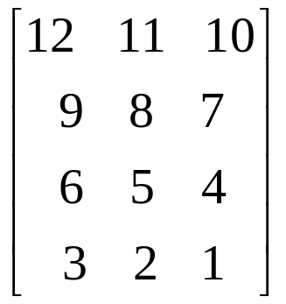
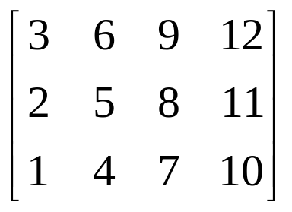
90° counterclockwise rotation
180° rotation
Rotated pixel block
Destination pixel array
RGB of destination pixel can be determined by averaging rotated ones (as antialiasing)
April 2010

Slide 16
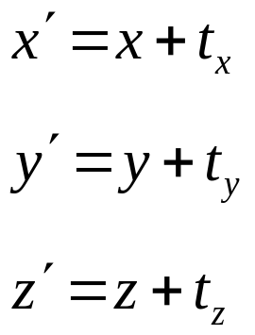

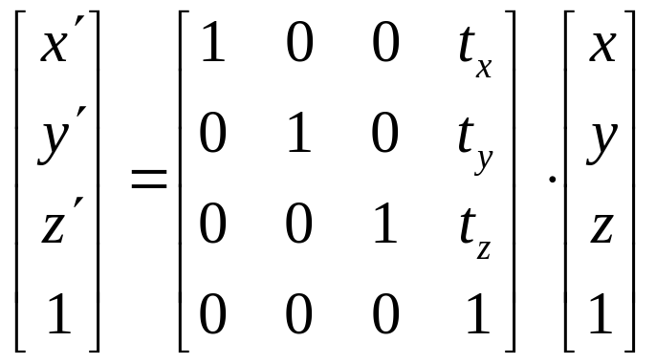
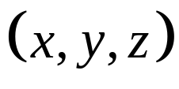

3D Transformations
Very similar to 2D. Using 4x4 matrices rather than 3x3.
Translation
April 2010

Slide 17
General 3D Rotation
Translate the object such that rotation axis passes through the origin.
Rotate the object such that rotation axis coincides with one of Cartesian axes.
Perform specified rotation about the Cartesian axis.
Apply inverse rotation to return rotation axis to original direction.
Apply inverse translation to return rotation axis to original position.
April 2010

Slide 18






April 2010

Slide 19
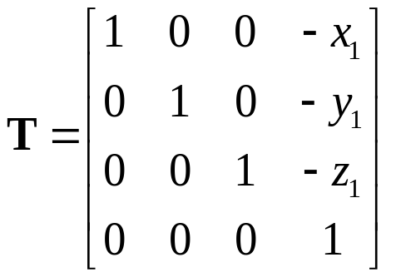
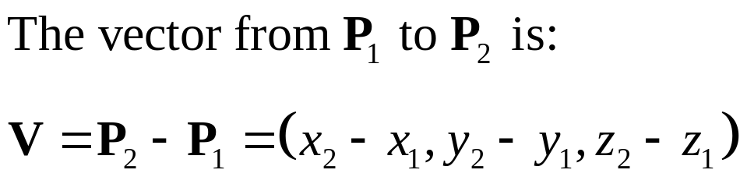
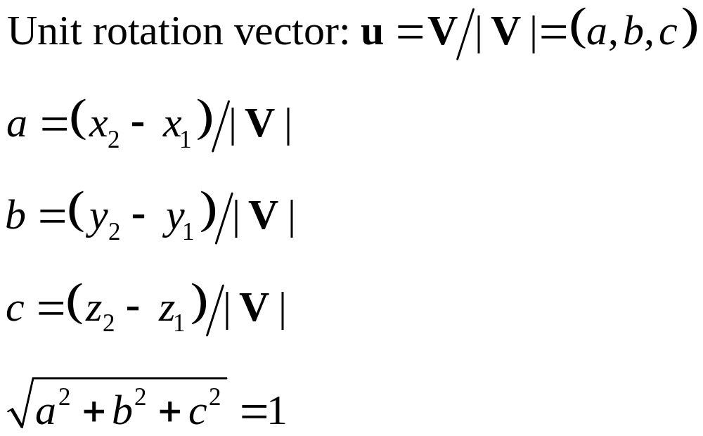

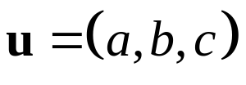
April 2010

Slide 20
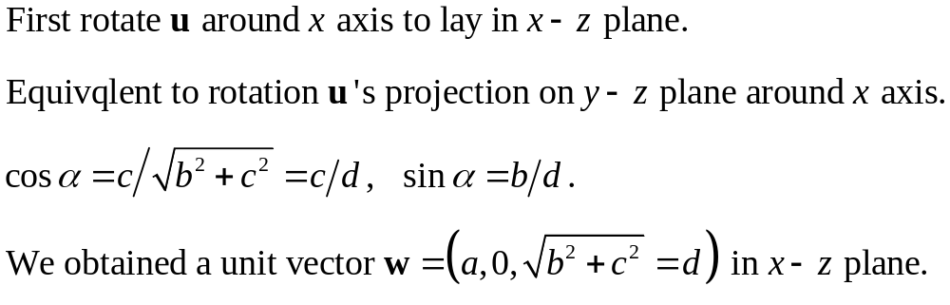
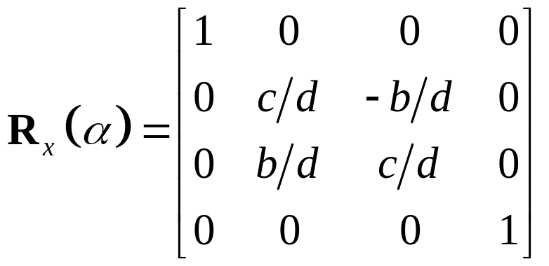


April 2010

Slide 21
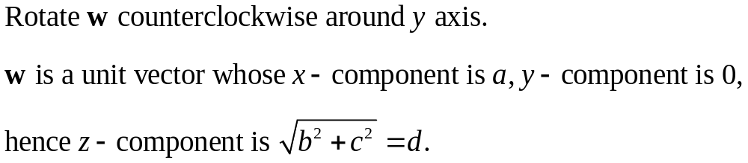

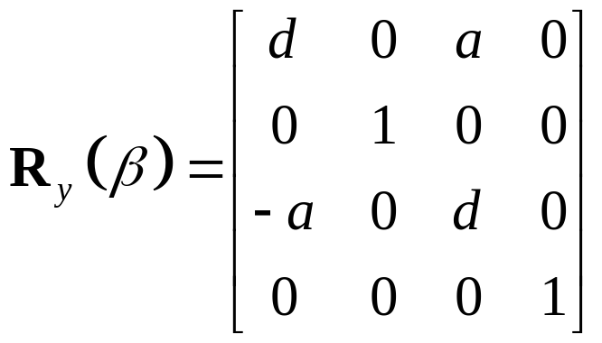

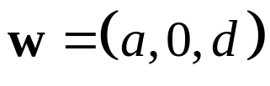
April 2010

Slide 22
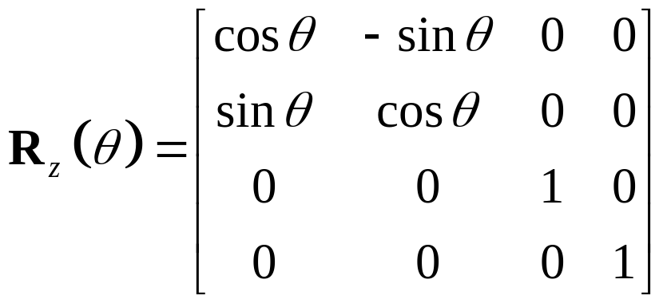
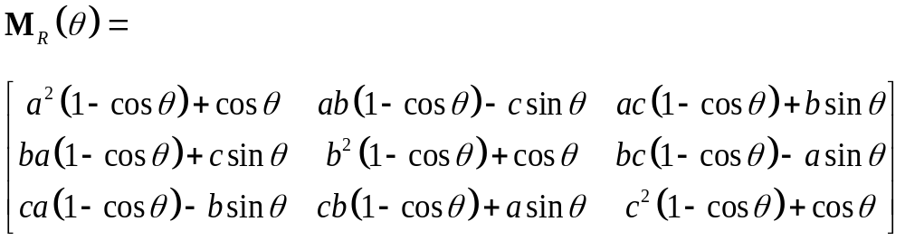
April 2010

Slide 23
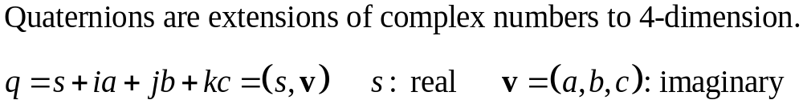
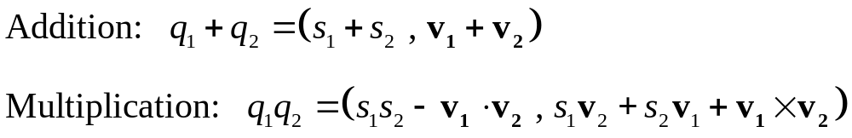
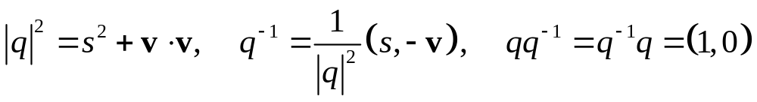
Efficient 3D Rotations by Quaternions
April 2010

Slide 24

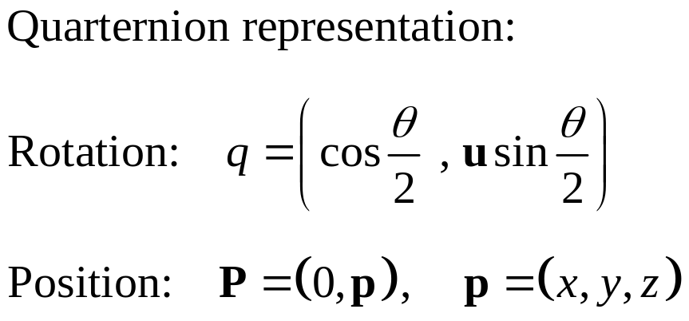


April 2010

Slide 25


3D Scaling
Enlarging object also moves it from origin
April 2010

Slide 26


Scaling with respect to a fixed point (not necessarily of object)
April 2010

